Slide 1
Game Playing

Slide 2
Game Playing
Why is game playing of interest to AI?
How are two player games different from state space search?
Perfect decision games.
Imperfect decision games.

Slide 3
Game Playing: Why?
Games have a small well structured state description that completely describes the real game state → so representation is easy.
People developing AI programs (i.e. intelligent programs) can test them on games.
Although easy to represent they are very hard problems. Chess state space is 10¹²⁰.

Slide 4
Game Playing: What?
Games are a form of multi-agent environment
  More than one agent in the environment and they affect each others success.
  Cooperative vs. competitive multi-agent environments.
  Competitive multi-agent environments give rise to adversarial problems a.k.a. games

Slide 5
Games vs. Search
Search – no adversary (Single Player Game)
  Solution is method for finding goal
  Evaluation function f(n): estimate of cost from start to goal through given node
Games – adversary (Multi-Player Game)
  Uncertainty: What move? Presence of the other player introduces a kind of uncertainty.
  Time limits force an approximate solution.
  Evaluation function → “goodness” of game position
  Examples: chess, checkers, othello, backgammon

Slide 6
Two Player Games
Two players: MAX and MIN
MAX moves first and they take turns until the game is over.
MAX searches for the best move:
  Initial state: e.g. board configuration of chess
  Successor function: list of (move,state) pairs specifying legal moves.
  Terminal test: Is the game finished?

Slide 7
Two Player Games
  Payoff or Utility function: Gives numerical value of terminal states. E.g. win (+1), loose (-1) and draw (0) in Tic-tac-toe
MAX uses search to determine the move at every turn.
Perfect Decision Games: if the search algorithm searches the complete search tree.
Imperfect Decision Games: no complete search, search is cut-off earlier.

Slide 8
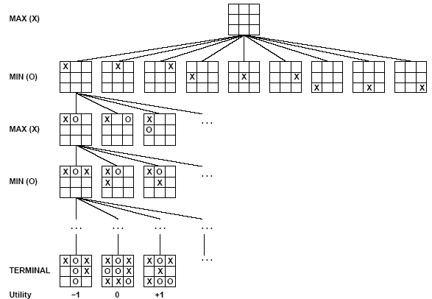
Tic-Tac-Toe
Game Search Tree for --
Tic-Tac-Toe

Slide 9
Min-Max Algorithm
At each turn a player must choose the best move to make, in that state of the game.
Search Algorithm to find the best move: Min-Max Algorithm.
Game
Formulation
Min-Max
Algorithm
Best Move

Slide 10
Min-Max Algorithm
Max wants to find the best move, calls Min-Max.
Min-Max
  generates the game tree in depth-first order until terminal states are reached
  applies the pay-off function to the terminal states to get pay-off value
  MinMax_Value(n) = maximum value of successors, if n is Max node; or minimum value of successors, if n is Min node.

Slide 11
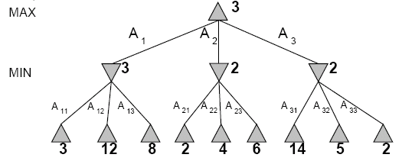
Min-Max Algorithm
The minimax decision

Slide 12
Min-Max Algorithm
When Max calls Min-Max algorithm to find the best move, Max assumes that Min will never make a mistake.
What if this assumption is not true? → Min making a mistake means Max will do even better.

Slide 13
Min-Max Algorithm: Properties
Completeness: Min-Max is complete I.e. guaranteed to return a move. ☺
Time Complexity: O(b^{m}) ☹
Space Complexity: O(bm) ☺
Optimality: It is optimal. ☺

Slide 14
Min-Max Algorithm: Problem
Perfect decision games, using Min-Max search all the way to the terminal states, which is not usually practical because of time limitations.
Solution → reduce the number of nodes generated and examined.
Alpha-beta pruning avoids generating some nodes.

Slide 15
Alpha-Beta Pruning
Uses two values alpha and beta:
  Alpha = value of best choice found so far at any choice point along the MAX path.
  Beta = value of best choice found so far at any choice point along the MIN path.
Two rules for terminating search:
  Stop search below any MIN node having a beta value <= to alpha value of any of its max ancestors.
  Stop search below any MAX node having an alpha value >= to the beta value of any of its min ancestors.

Slide 16
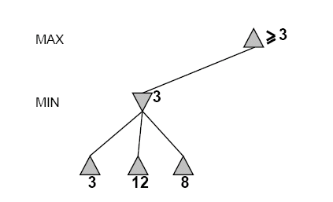
Alpha-Beta Example
Range of possible values
[-∞,+∞]
[-∞, +∞]

Slide 17
Alpha-Beta Example
[-∞,+∞]
[-∞,3]

Slide 18
Alpha-Beta Example
[-∞,+∞]
[-∞,3]

Slide 19
Alpha-Beta Example
[3,+∞]
[3,3]

Slide 20
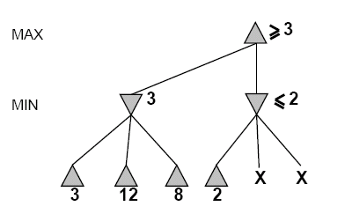
Alpha-Beta Example
[3,+∞]
[3,3]
[-∞,2]

Slide 21
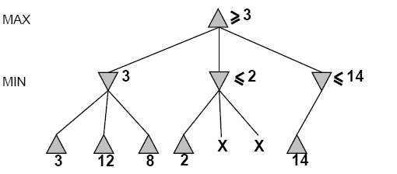
Alpha-Beta Example
[3,14]
,
[3,3]
[-∞,2]
[-∞,14]

Slide 22
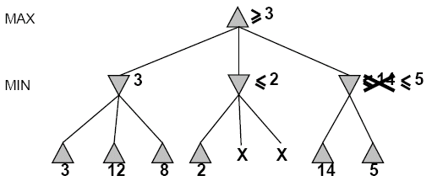

Alpha-Beta Example
[3,5]
,
[3,3]
[−∞,2]
[-∞,5]

Slide 23
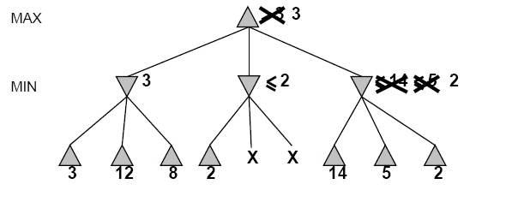
Alpha-Beta Example
[3,3]
[3,3]
[−∞,2]
[2,2]

Slide 24
Alpha-Beta Example
[3,3]
[3,3]
[-∞,2]
[2,2]

Slide 25
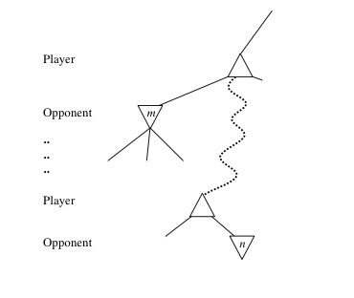
Alpha-Beta: General Case
Consider a node n somewhere in the tree
If player has a better choice at
  Parent node of n
  Or any choice point further up
n will never be reached in actual play.
Hence when enough is known about n, it can be pruned.

Slide 26
Alpha-Beta Pruning
Pruning does not affect final results
Entire subtrees can be pruned.
Good move ordering improves effectiveness of pruning
With “perfect ordering,” time complexity is O(b^{m/2})
  Alpha-beta pruning can look twice as far as minimax in the same amount of time
Repeated states are again possible.

Slide 27
Imperfect Games
Problem with perfect games: Min-max and alpha-beta pruning can take a long time…
Imperfect decision games
  cut-off search earlier at some depth-limit (apply a CUT-OFF test instead of TERMINAL TEST)
  Apply a heuristic function EVAL instead of a PAYOFF function.

Slide 28
Heuristic EVAL function
Idea: produce an estimate of how good the state is in a game.
A good quality EVAL improves performance a lot.
Requirements:
  EVAL should order terminal-nodes in the same way as PAYOFF.
  It should be easy to compute.
  For non-terminal states the EVAL should be strongly correlated with the actual chance of winning.

Slide 29
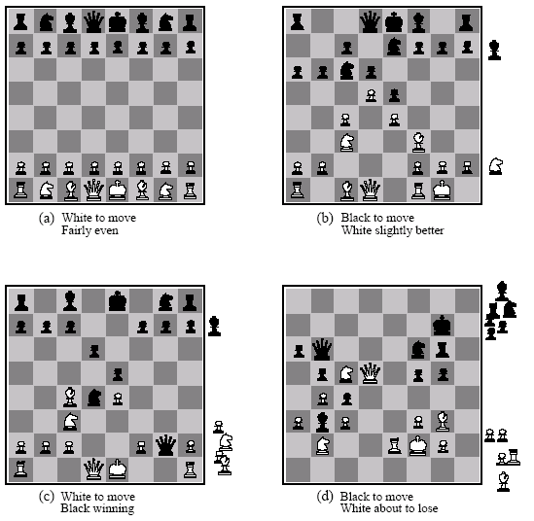
Heuristic EVAL function
Eval(s) = w₁ f₁(s) + w₂ f₂(s) + … + w_{n}f_{n}(s)

Slide 30
Summary
State Space Search can be regarded as a single player game.
Considered two player games: perfect & imperfect decision
Min-Max algorithm is used to determine the best move at every turn.
Min-Max can be improved by alpha-beat pruning.
Imperfect games cut-off search at a depth-limit to improve performance.

